Slide 1
Unit-2
Image Transformation & Filtering

Slide 2
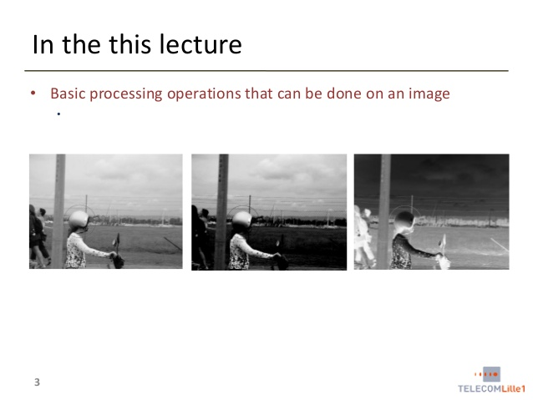

Slide 3
Spatial Domain vs. Transform Domain
Spatial domain
image plane itself, directly process the intensity values of the image plane
Transform domain
process the transform coefficients, not directly process the intensity values of the image plane

Slide 4
Intensity Transformation Functions
When you are working with gray-scale images, sometimes you want to modify the intensity values.
For instance, you may want to reverse black and the white intensities or you may want to make the darks darker and the lights lighter.
An application of intensity transformations is to increase the contrast between certain intensity values so that you can pick out things in an image.

Slide 5
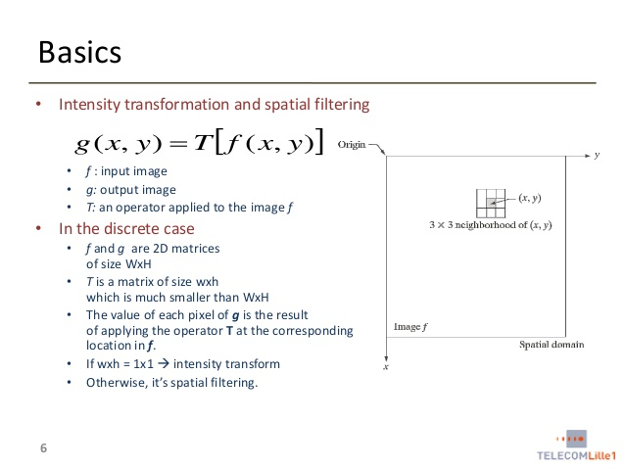

Slide 6
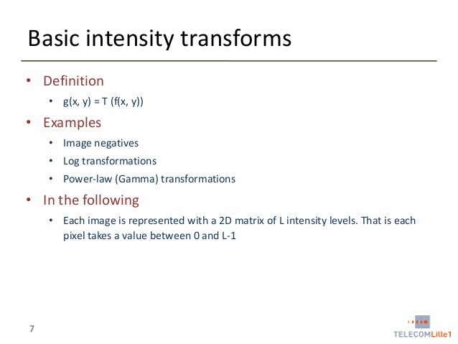

Slide 7
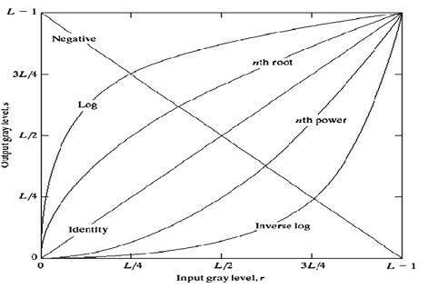
The overall graph of these transitions has been shown below.

Slide 8
Linear transformation
Linear transformation includes simple identity and negative transformation.
Identity transition is shown by a straight line. In this transition, each value of the input image is directly mapped to each other value of output image.
That results in the same input image and output image. And hence is called identity transformation.

Slide 9
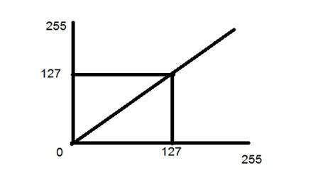
It has been shown below:

Slide 10
Negative transformation
The second linear transformation is negative transformation, which is invert of identity transformation.
In negative transformation, each value of the input image is subtracted from the L-1 and mapped onto the output image.

Slide 11
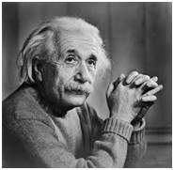
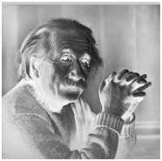
Input Image
Output Image

Slide 12
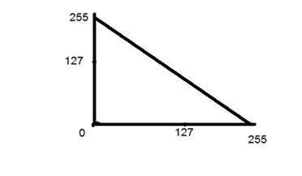
In this case the following transition has been done. s = (L – 1) – r
since the input image of Einstein is an 8 bpp image, so the number of levels in this image are 256. Putting 256 in the equation, we get this s = 255 – r
So each value is subtracted by 255 and the result image has been shown above. So what happens is that, the lighter pixels become dark and the darker picture becomes light. And it results in image negative.

Slide 13
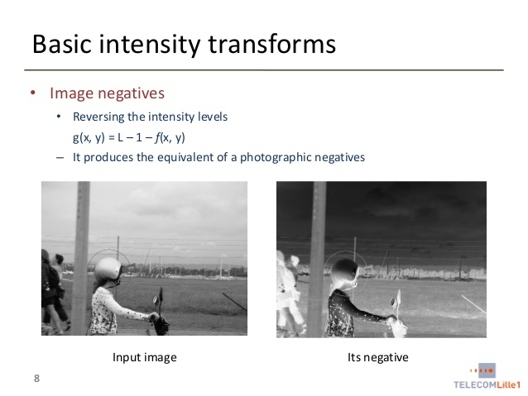

Slide 14
The Photographic Negative is probably the easiest of the intensity transformations to describe.
Assume that we are working with gray scale double arrays where black is 0 and white is 1.
The idea is that 0's become 1's, 1's become 0's, and any gradients in between are also reversed.

Slide 15
Logarithmic transformations
Logarithmic transformation further contains two type of transformation. Log transformation and inverse log transformation.

Slide 16
Log transformation
The log transformations can be defined by this formula
s = c log(r + 1).
Where s and r are the pixel values of the output and the input image and c is a constant. The value 1 is added to each of the pixel value of the input image because if there is a pixel intensity of 0 in the image, then log (0) is equal to infinity. So 1 is added, to make the minimum value at least 1.
During log transformation, the dark pixels in an image are expanded as compare to the higher pixel values. The higher pixel values are kind of compressed in log transformation. This result in following image enhancement.
The value of c in the log transform adjust the kind of enhancement you are looking for.

Slide 17
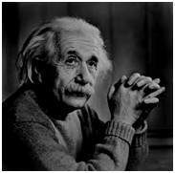
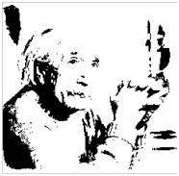
Input Image
Log Transform Image
The inverse log transform is opposite to log transform.

Slide 18
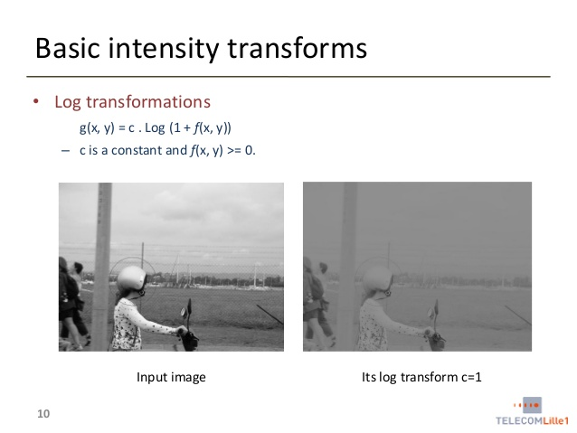

Slide 19
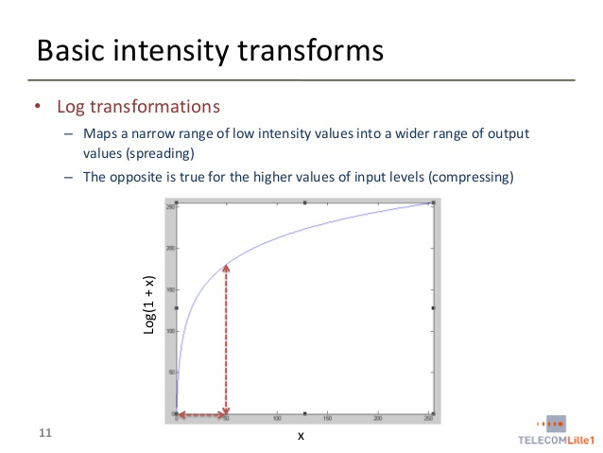

Slide 20
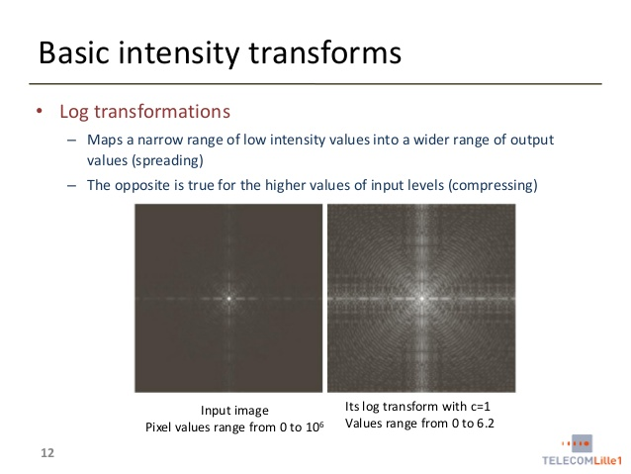

Slide 21
Power – Law transformations
There are further two transformation is power law transformations, that include nth power and nth root transformation.
These transformations can be given by the expression: s=cr^γ
This symbol γ is called gamma, due to which this transformation is also known as gamma transformation.

Slide 22
Variation in the value of γ varies the enhancement of the images. Different display devices / monitors have their own gamma correction, that’s why they display their image at different intensity.
This type of transformation is used for enhancing images for different type of display devices. The gamma of different display devices is different. For example Gamma of CRT lies in between of 1.8 to 2.5, that means the image displayed on CRT is dark.
Correcting gamma.
s=cr^γ
s=cr^(1/2.5)

Slide 23
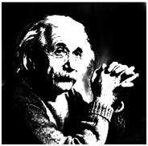
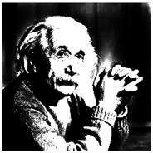
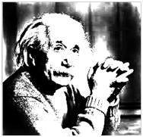
Gamma = 10
Gamma = 8
Gamma = 6

Slide 24
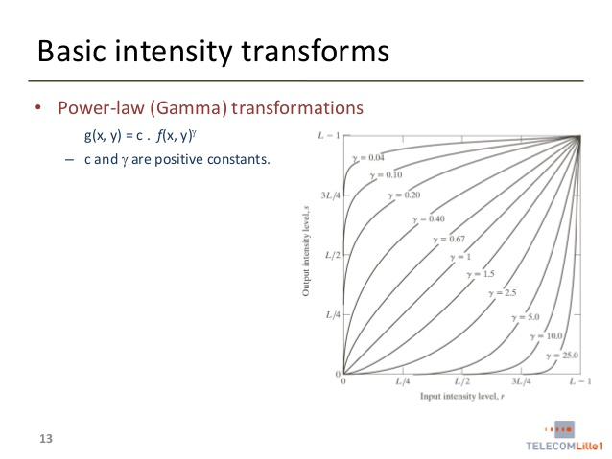

Slide 25
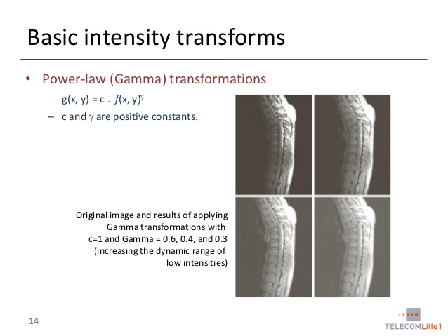

Slide 26
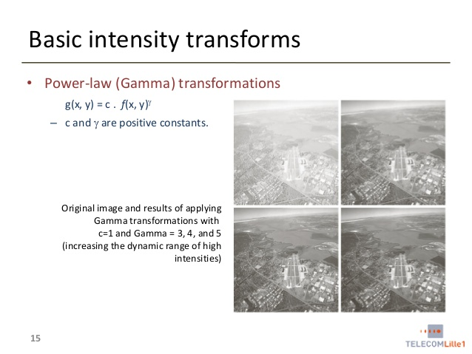

Slide 27
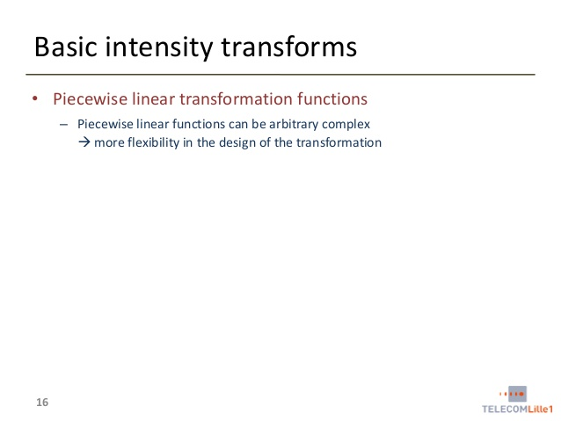

Slide 28
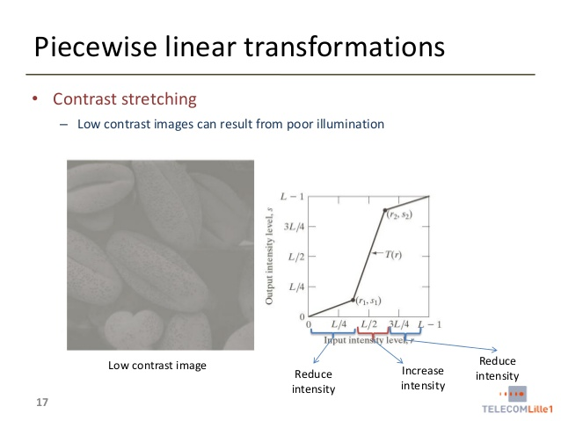

Slide 29
